Slide 1
Computer Graphics
3D Transformations

Slide 2
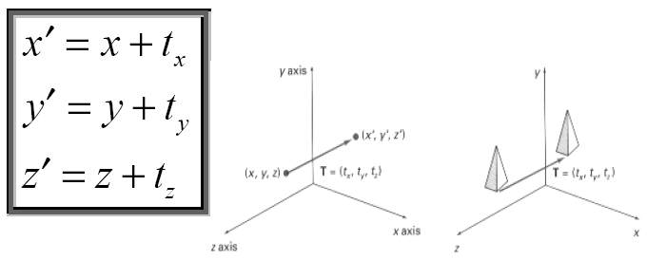
Translation

Slide 3
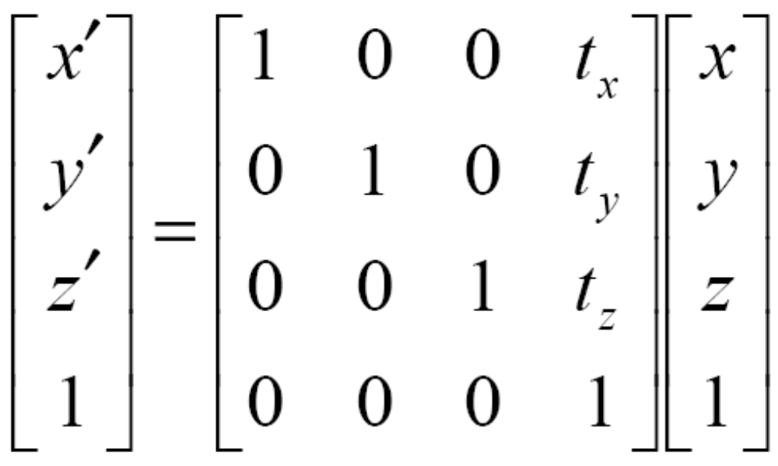
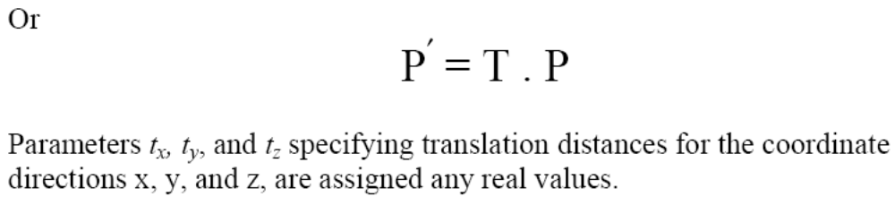

Slide 4
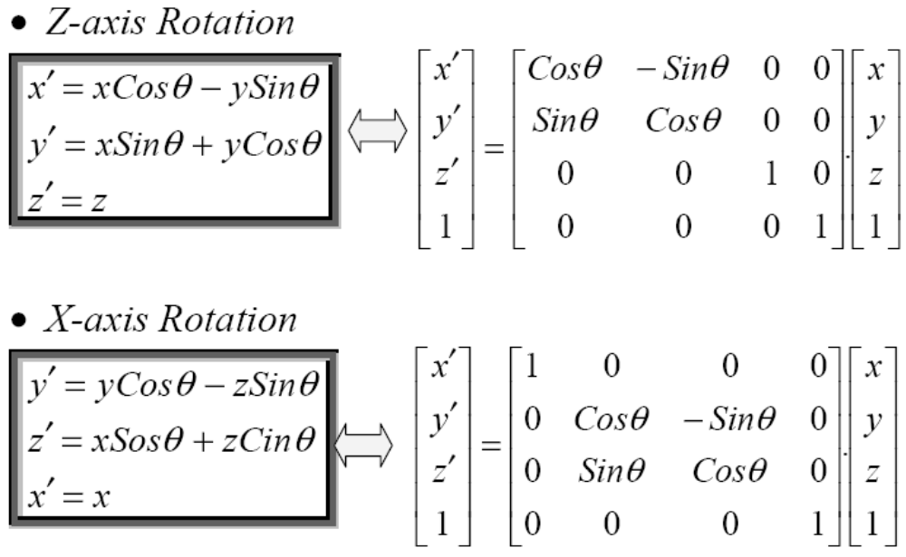
Rotation

Slide 5
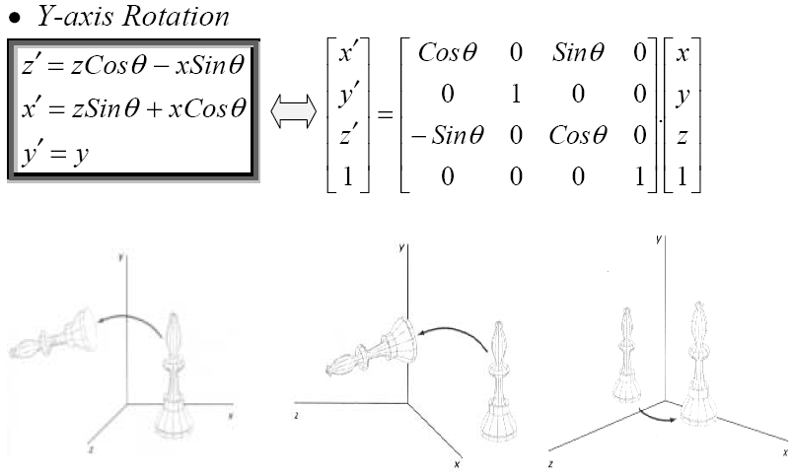
Rotation

Slide 6
Rotation
Parallel to one of the Coordinate Axis
In special cases where an object is to be rotated about an axis that is parallel to one of the coordinate axis, we can obtain the desired rotation with the following transformation sequence.
Translate the object so that the rotation axis coincides with the parallel coordinate axis (for simplicity, let us take x-axis).
Perform the specified rotation about that axis.
Translate the object so that the rotation axis is moved back to its original position.

Slide 7
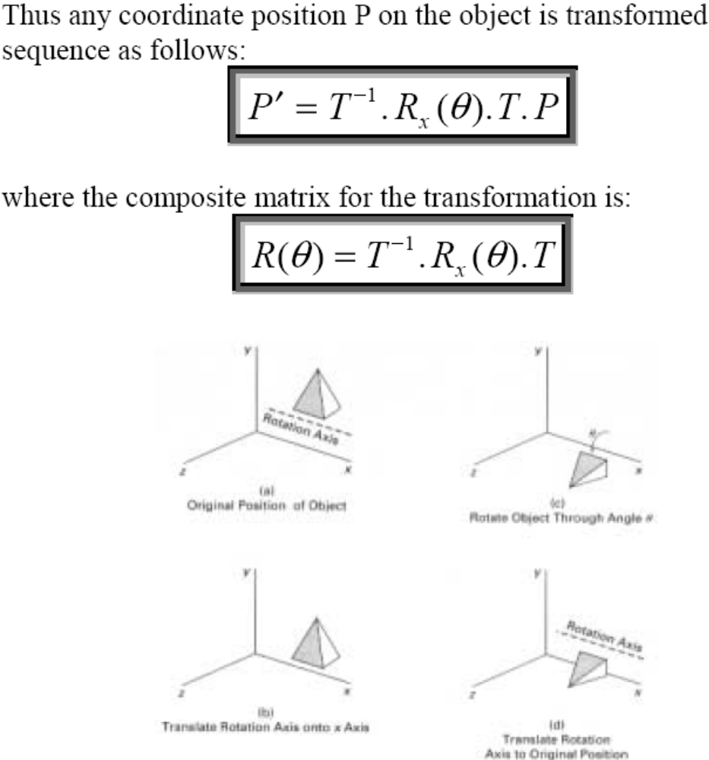
Rotation

Slide 8
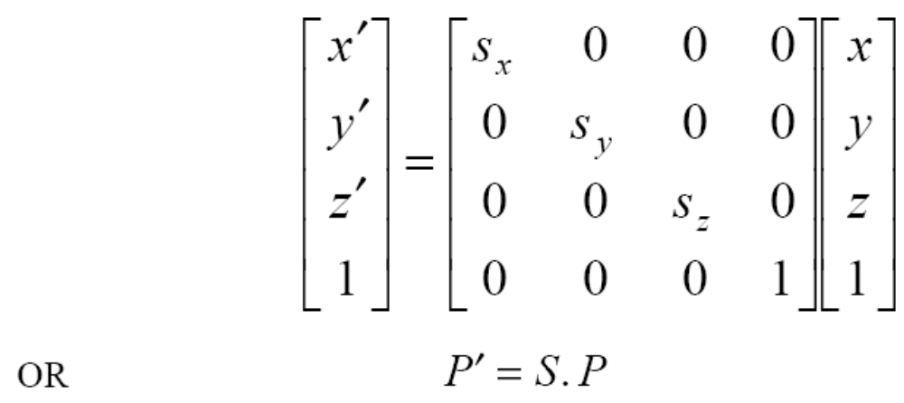
Scaling
The matrix expression for the scaling transformation of a position P = (x, y, z) relative to coordinate origin can be written as:

Slide 9
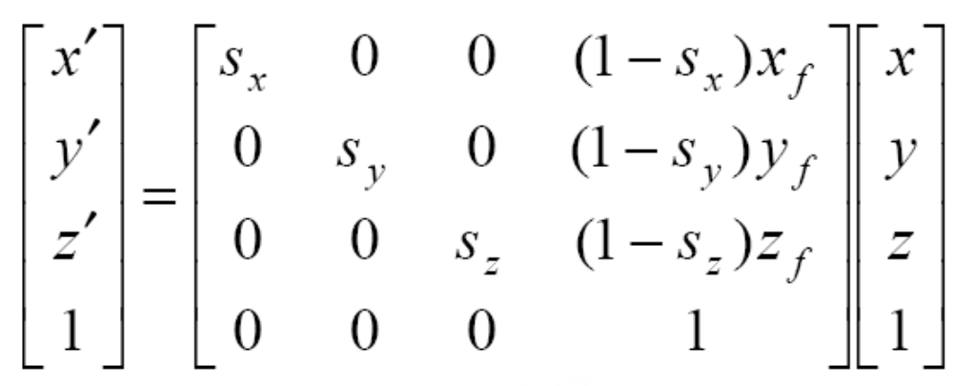
Scaling
The matrix representation for an arbitrary fixed-point (x_{f}, y_{f}, z_{f}) can be expressed as:

Slide 10
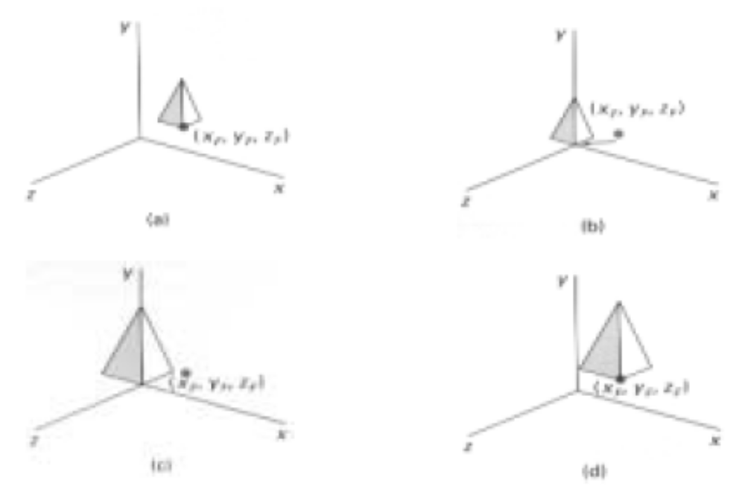
Scaling

Slide 11
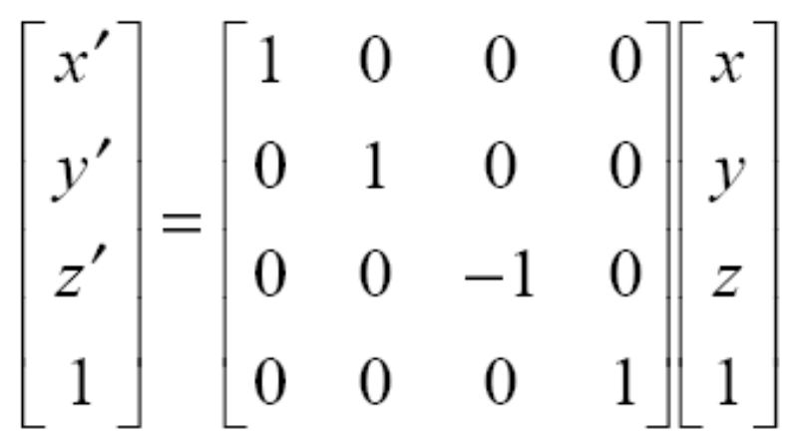
Reflections
The matrix expression for the reflection transformation of a position P = (x, y, z) relative to x-y plane can be written as:
Transformation matrices for inverting x and y values are defined similarly, as reflections relative to yz plane and xz plane, respectively.

Slide 12
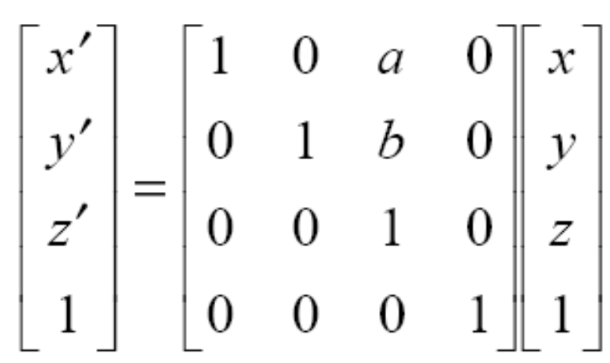
Shears
The matrix expression for the shearing transformation of a position P = (x, y, z), to produce z-axis shear, can be written as:

Slide 13
Shears
Parameters a and b can be assigned any real values. The effect of this transformation is to alter x- and y- coordinate values by an amount that is proportional to the z value, while leaving the z coordinate unchanged.
Shearing transformations for the x axis and y axis are defined similarly.

